Slide 1


Microservices in real life – with Node & Dapr.io & Apache Kafka November 2022
Lucas Jellema Architect & CTO AMIS | Conclusion
labs: github.com/lucasjellema/fontys-fall2022-microservices-messaging-kafka-dapr
Notes:
Wat is een microservice? (waarom, problemen met monolitische applicaties, hoe microservice architectuur, generieke voorzieningen & platform voor microservices, data & events als glue tussen microservices)
Hier alvast stilstaan bij het belang van een event broker en een korte intro van Kafka (meer in college 2)
Implementatie van microservices: afhandelen van http requests, consumeren en publiceren van events, doen van http calls: wat zijn activiteiten die iedere microservice moet uitvoeren? (state mgt, pub/sub, secrets, config mgt, aanroepen 3rd party (cloud) services, ..)
Introductie en demo van Dapr.io framework – de personal assistant die iedere applicatie eenvoudig laat aansluiten op generieke voorzieningen én die applicaties (microservices) met elkaar laat interacteren op ontkoppelde wijze; note: ik zal wijzen op de ondersteuning in Dapr.io voor diverse technologieën zoals RabbitMQ, MySQL, Redis
Handson met Dapr – meegeleverde applicaties in Java en C#
Zelf implementeren van microservice – introductie van NodeJS ;
Handson: afbouwen eenvoudige services in NodeJs en via Dapr.io interactie met elkaar en met generieke voorzieningen

Slide 2

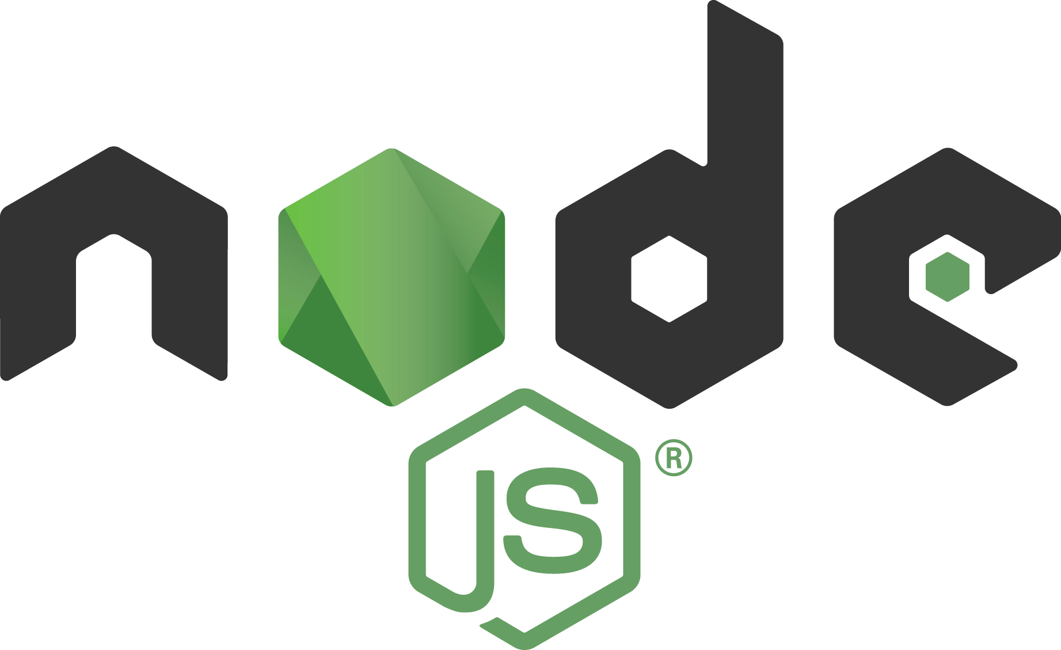
Overview
Recap Part One (October)
Asynchronous communication – Messaging for people and systems
Introducing Apache Kafka – what, why, when, how
Microservices
Programmatic interaction with Apache Kafka from Node
Part Two (today)

Slide 3
Overview
Recap Part One (October)
Asynchronous communication – Messaging for people and systems
Introducing Apache Kafka – what, why, when, how
Microservices
Programmatic interaction with Apache Kafka from Node
Part Two (today)
Interactions between microservices and with “the wider world”
Dapr.io – personal assistant for applications & distributed application runtime
no plumbing in your application code – fewer dependencies, faster uptake, easier switch
gRPC, discovery, routing, monitoring, cache, store, message,
Multi-microservice with Apache Kafka, Node and Dapr.io
Adding more platform components and languages
Redis, RabbitMQ, MySQL | PostgreSQL
Java, Go, Python

Slide 4


What does the Twitter for System Driven Event Interaction look like?
Decoupled communication – organized per topic
0, 1 or many Consumers per Topic
Scalable number of messages (and parties)
Reliable (distributed)
Full history
Open: libraries in many technologies & REST APIs

Slide 5
What does the Twitter for System Driven Event Interaction look like?
Decoupled communication – organized per topic
0, 1 or many Consumers per Topic
Scalable number of messages (and parties)
Reliable (distributed)
Full history
Open: libraries in many technologies & REST APIs
Near real-time fast
No Rate Limit
No enforced size limit
Anything goes (it’s all byte[])
On premises or in cloud, private or trusted
Very much for programmatic use

Slide 6
Events/Messages
Consumers
Producers
Robust, QoS, Scalable, Fast, History Retention
Order preserved
Containerized/Cloud-enabled
Open

Slide 7
Consumers
tcp
Producers
tcp
Client polls Broker for messages

Slide 8
Consumers
Producers
Topic

Slide 9
Kafka terminology
Topic
Message
== ByteArray
Broker
Producer
Consumer
Offset
Message
Key
Value
Time
Producer
Consumer
Broker
Topic
offset (for a specific consumer)

Slide 10
Key
Value
Time
Consumers
Producers
Broker
Topic

Slide 11
Key
Value
Time
Consumers
Producers
Broker
Topic
Topic
Topic
Message Log

Slide 12
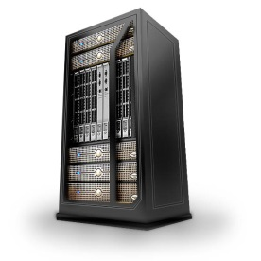

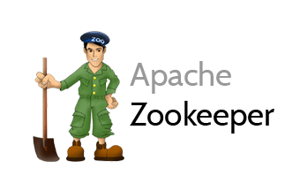
Cluster
Consumers
tcp
Producers
tcp
Broker
Topic
Message Logs - replicas

Slide 13
Cluster
Consumers
tcp
Producers
tcp
Broker
Topic
Partition
Consumer Group team of collaborating consumers;
each consumer in the group has exclusive read on one or more partitions
Partition Log
Replica

Slide 14
What’s so special?
Durable transactions
Scalable
High volume
High speed
Parallel processing
Available
Distributed
Open
Quick start
Free (no license costs)
“Self Fulfilling Prophecy” leading to “de facto standard” (positive feedback loop feeding from buzz around Kafka)
Eco system, tools/libraries/resources, cloud services
“Kafka compliant” implementations

Slide 15

What is a microservice?
Why is a microservice?
Problems with (BIG) applications
complex
inflexible to change (when roll out changes)
long test, long build
impossible to upgrade technology (everything is affected)
hard to scale
hard to migrate (to different technology)
hard to learn (for new staff)

Slide 16

Final Demo
Microservices
Microservice

Slide 17
What is a microservice?
Not TOO big (but not too small either)
understandable by normal human beings – easy to on board new team members
easy to change – allow for agile functional and non functional evolution
functionally cohesive/logical collection of features => domain
design time decoupled, clear standards based external interfaces: API & events
low external impact of: change, refactor, move, migrate, scale, failure
reliable, robust, resilient
clear ownership (business sponsor; one IT team builds it, runs it, evolves it)
contains everything needed to run [on a generic platform]
application software, libraries/frameworks, platform configuration
pipelines for CI and CD, tests, documentation, infra as code

Slide 18
The Microservice
HTTP REST/JSON
API
µ

Slide 19
Extended API of microservice
API
Runtime Interaction Interface
REST API Resources & Operations – query and URL parameters, message formats
Events Consumed – alternative way to call | activate a microservice
Reference to entry in Event Catalog
May include reference to shared Cache Resource
Events Produced – alternative output from microservice
Event can be an asynchronous response to a stateless consumer
Deployment & Configuration Interface
Injectable dependencies – reference to cache, logging, storage URL, …
Configurable meta-data – parameters, log level, credential (key)

Slide 20
Interaction between Microservices
synchronous, route (& discover), retry, load balance, cache, monitor, authorize, TLS
API Gateway | Service Mesh
API
API
Event Broker
asynchronous, persistent, reliability guarantees

Slide 21
Interaction between Microservices
API Gateway | Service Mesh
API
API
Event Broker

Slide 22




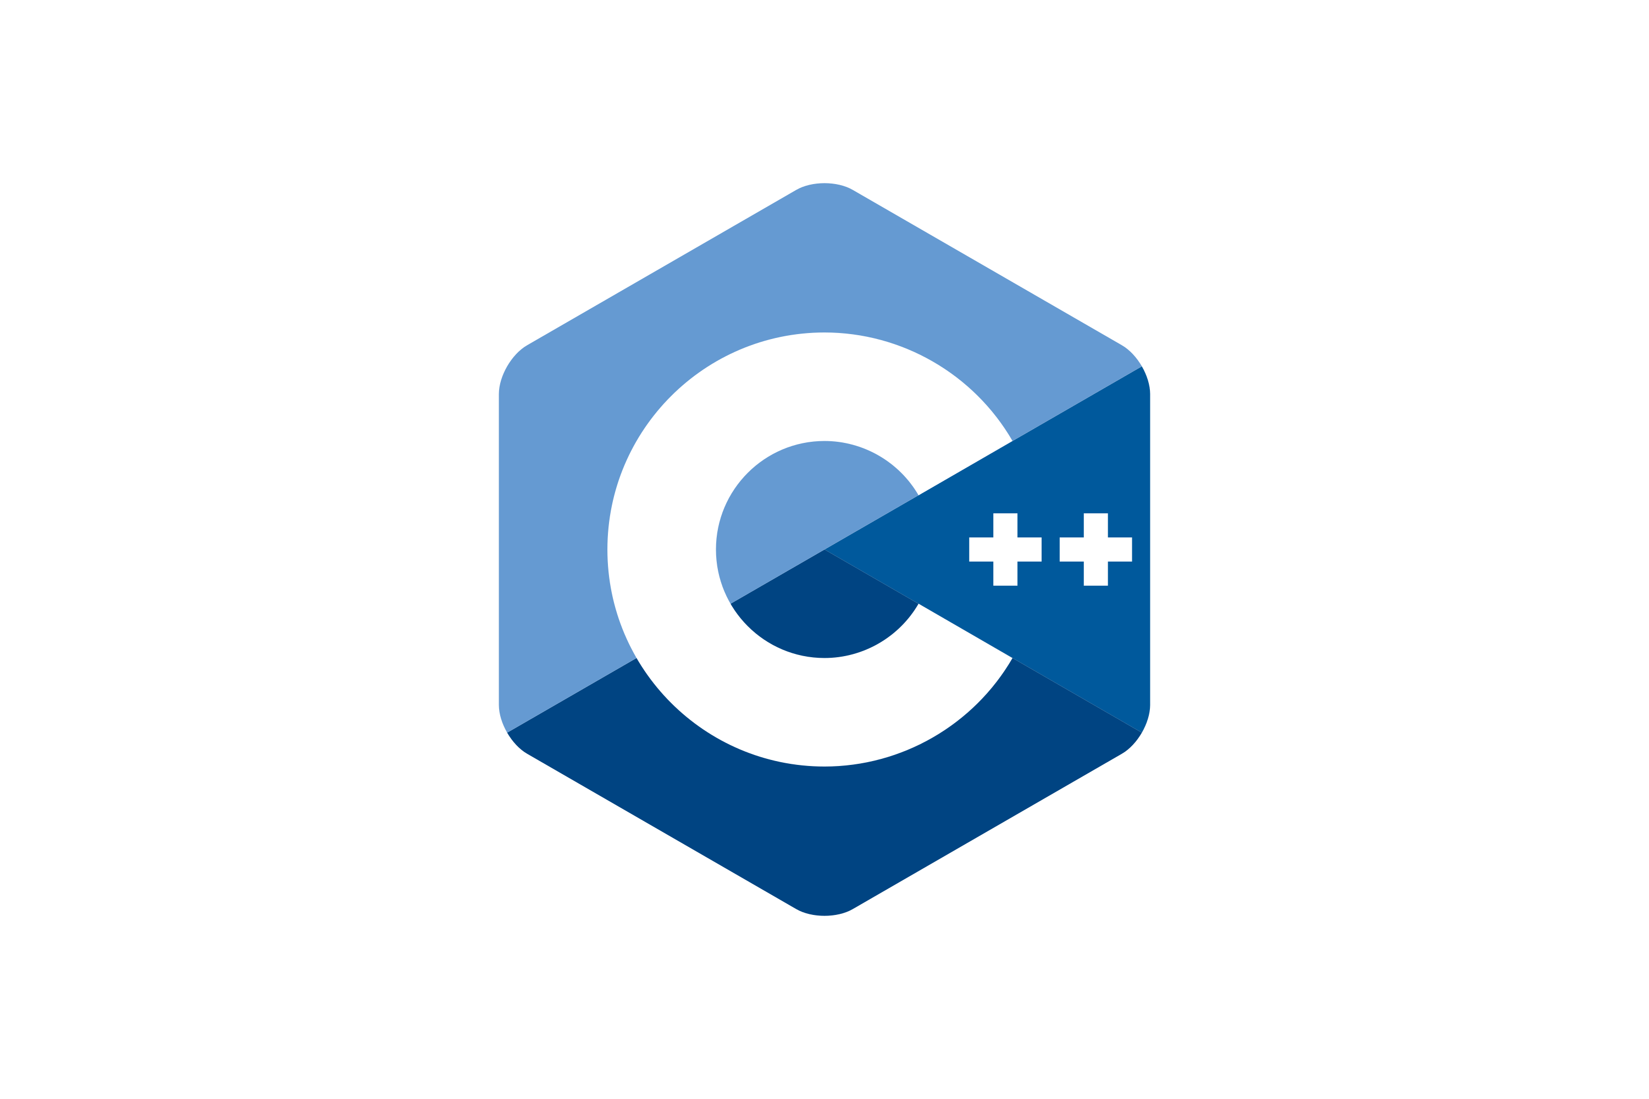




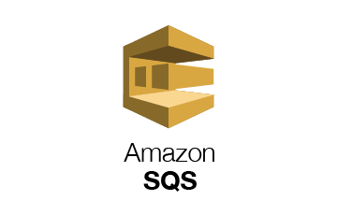




Interaction between Microservices
API Gateway | Service Mesh
API
API
Event Broker
Kafka
Redis
Azure
Service Bus
RabbitMQ
GCP
Pub/Sub

Slide 23
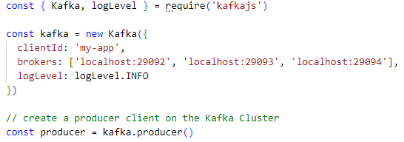
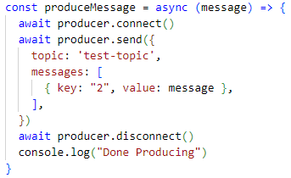
Node and Kafka – the simplest producer
1
2
test-topic
9092
9093
9094
2
1
Client
Application

Slide 24

Considerations
Code has dependencies on Apache Kafka (libraries)
Code contains a lot of plumbing
How to monitor/trace the interactions from the application with the topic?
How to switch to another message broker?
Quite some knowledge about Kafka is required (and is injected into the code) – just to simply publish a message!
And: for other generic actions – put/get to/from cache, store/retrieve from database, invoke an API/be invoked as API, … we have similar issues

Slide 25
What do most microservices do?
Store and retrieve state
Read runtime secrets and configuration values
Publish “observability data”
Subscribe to event topic and handle incoming events
Publish events to event topic
Interact with other microservices
Invoke external services
Run microservice specific business logic
This requires quite a bit of repetitive “plumbing” tied to specific technologies – not meaningful effort [from a business functionality perspective]

Slide 26

Introducing the Personal Assistant
the companion to your application that handles plumbing details for incoming calls and outgoing requests regardless of protocol and technology

Slide 27
Dapr Distributed Application Runtime
introduction

Slide 28


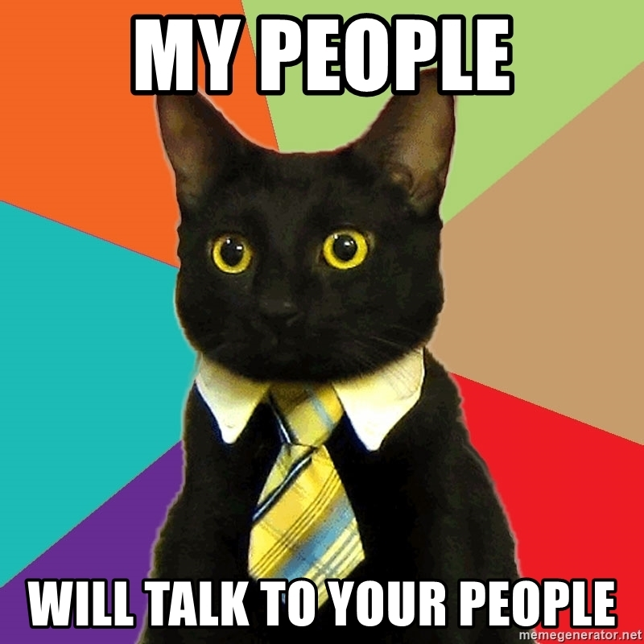

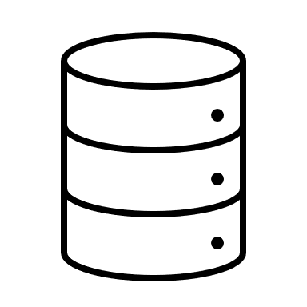

Dapr.io
Microservice or Monolith
Launched by Microsoft (2019)
Application runtime framework – supporting cloud native and serverless
Every application gets a uniform Personal Assistant that takes care of common tasks
remember (take note and reproduce)
keep log
restrict access
handle incoming
route outgoing
interact with other PAs (and their apps)
Personal Assistant (Dapr)
Application
Personal Assistant (Dapr)
Personal Assistant (Dapr)
Personal Assistant (Dapr)
Personal Assistant (Dapr)
Personal Assistant (Dapr)

Slide 29

Dapr.io
Personal Assistant is Dapr Side Car
companion process or side car container in Kubernetes Pod
Application delegates tasks to side car
Application
Dapr sidecar
Dapr API
My App
HTTP/gRPC

Slide 30



State management
Redis Cache
My App
key | value
myApp-weapon | "DeathStar"
POST
http://localhost:3500/v1.0/state/corpdb
[{
"key": "weapon",
"value": "DeathStar"
}]

Slide 31

State management
Redis Cache
Azure CosmosDB
My App
key | value
myApp-weapon | "DeathStar"
key | value
myApp-weapon | "DeathStar"
GET
http://localhost:3500/v1.0/state/corpdb/planet
"DeathStar"

Slide 32
State management
Azure CosmosDB
Redis Cache
My App
key | value
myApp-weapon | "DeathStar"
key | value
myApp-weapon | "DeathStar"
GET
http://localhost:3500/v1.0/state/corpdb/planet
"DeathStar"

Slide 33
Dapr state API
corpdb-redis.yaml
apiVersion: dapr.io/v1alpha1
kind: Component
metadata:
name: corpdb
spec:
type: state.redis
version: v1
metadata:
- name: redisHost
value: redis-master.default.svc.cluster.local:6379
- name: redisPassword
secretKeyRef:
name: redis-secret
key: redis-password
Save state
POST /v1.0/state/corpdb
Retrieve state
GET /v1.0/state/corpdb/mystate
Delete state
DELETE /v1.0/state/corpdb/mystate
Get bulk state
POST /v1.0/state/corpdb/bulk
Submit multiple state transactions
POST /v1.0/state/corpdb/transaction

Slide 34
Dapr state API
corpdb-cosmosdb.yaml
apiVersion: dapr.io/v1alpha1
kind: Component
metadata:
name: corpdb
spec:
type: state.azure.cosmosdb
version: v1
metadata:
- name: url
value: corpdb.documents.azure.com
- name: masterKey
secretKeyRef:
name: master-key
key: cosmos-key
- name: database
value: orders
- name: collection
value: processed
Save state
POST /v1.0/state/corpdb
Retrieve state
GET /v1.0/state/corpdb/mystate
Delete state
DELETE /v1.0/state/corpdb/mystate
Get bulk state
POST /v1.0/state/corpdb/bulk
Submit multiple state transactions
POST /v1.0/state/corpdb/transaction

Slide 35








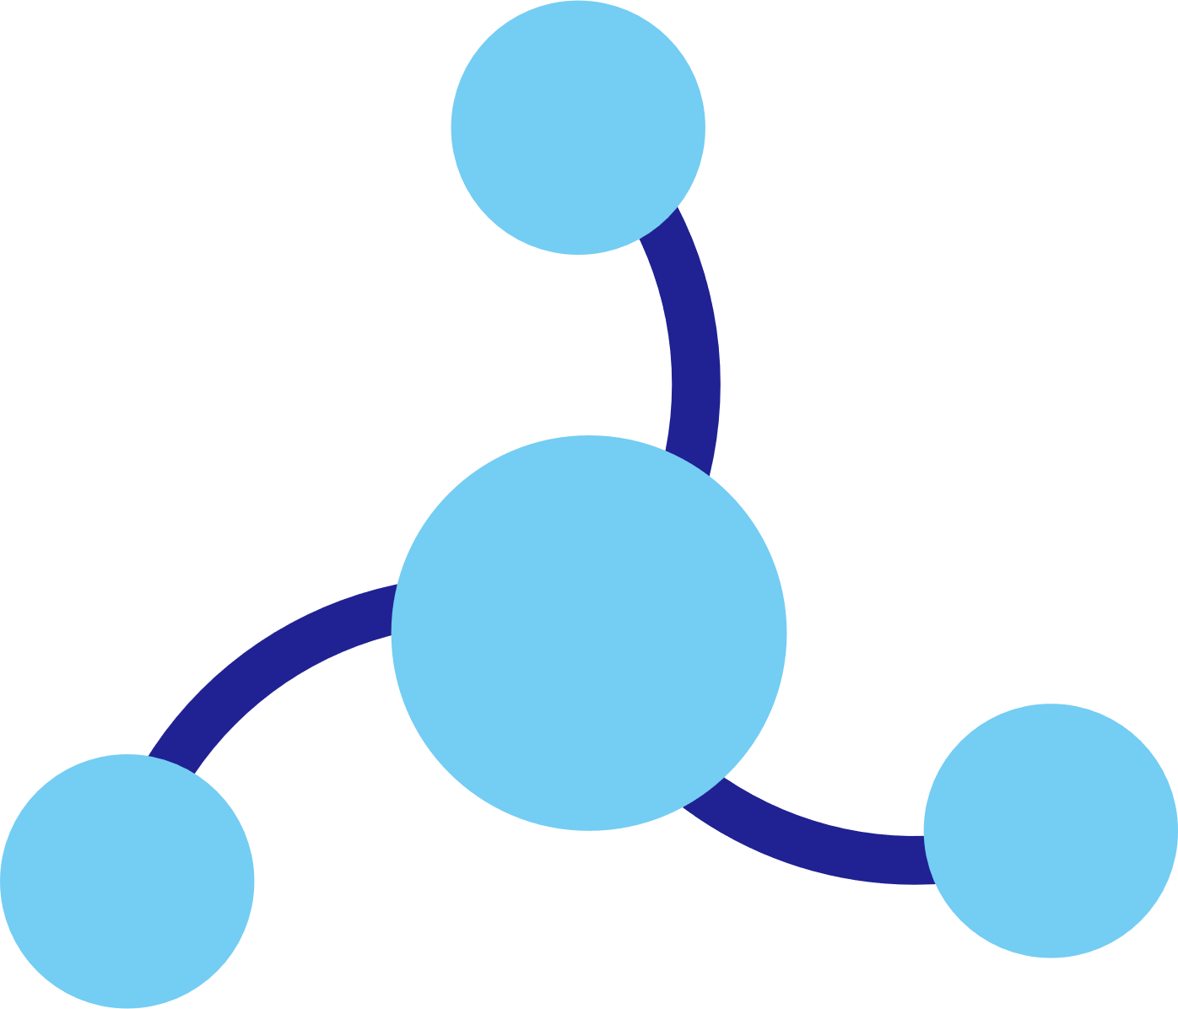




Run Dapr Locally
Dapr Components
dapr run myapp
State Stores
Launch application
Launch sidecar process
Set env variables
PubSub
Brokers
My App
Use components
Bindings
& Triggers
Zipkin
tracing
Zipkin
Send distributed tracing
Secret Stores
Redis
state store
Redis
Save and retrieve state
Publish and subscribe to messages
dev machine or VM – local or cloud
Observability

Slide 36
Run Dapr Locally – Default Redis Statestore
dapr run --app-id myapp --dapr-http-port 3510
My App
Zipkin
tracing
Zipkin
Send distributed tracing
curl -X POST -H "Content-Type: application/json" -d '[{ "key": "name", "value": "Bruce Wayne"}]' http://localhost:3510/v1.0/state/statestore
Redis
state store
Redis
Save and retrieve state
key | value
myapp-name | "Bruce Wayne"
curl http://localhost:3510/v1.0/state/statestore/name

Slide 37

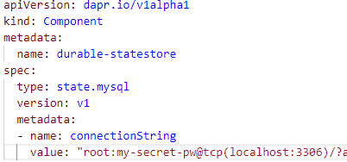
Run Dapr Locally - add MySQL Database as statestore
dapr run --app-id myotherapp --dapr-http-port 3510 --components-path .
key | value
myapp-name | "John Willis"
Launch application
Launch sidecar process
Set env variables
MySQL
database
Save and retrieve state
myotherapp
Zipkin
tracing
Zipkin
Redis
state store
mysql-statestore.yaml
Redis
curl -X POST -H "Content-Type: application/json" -d '[{ "key": "name", "value": "John Willis"}]' http://localhost:3510/v1.0/state/durable-statestore
key | value
myapp-name | "Bruce Wayne"
curl http://localhost:3510/v1.0/state/durable-statestore/name

Slide 38
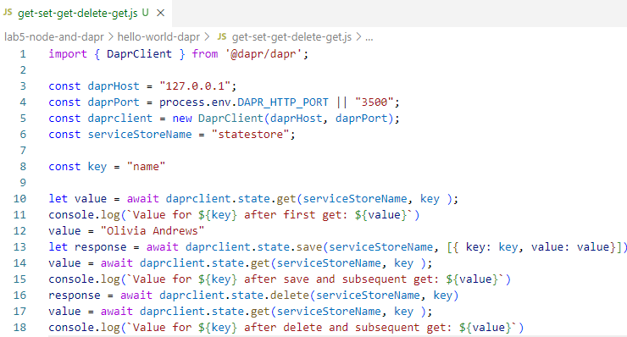
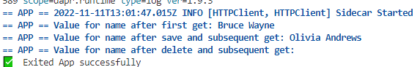
dapr run --app-id myapp --app-port $APP_PORT --dapr-http-port $DAPR_HTTP_PORT node get-set-get-delete-get.js
key | value
myapp-name | "Bruce Wayne"
Redis
state store
Redis
My App

Slide 39
prepare Dapr Client – link to Dapr Side Car
get piece of state through Dapr Client
save piece(s) of state through Dapr Client
delete piece(s) of state through Dapr Client
My App

Slide 40

Microservice building blocks
HTTP API
gRPC API
Service-to-service invocation
State management
Publish and subscribe
Resource bindings and triggers
Actors
Observability
Secrets
Extensible

Slide 41

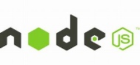



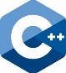

Any language and framework
Standard APIs accessed over http/gRPC protocols from user service code
Runs as local “side car library” dynamically loaded at runtime for each service
Application code
Microservices written in
Any code or framework…
HTTP API
gRPC API
Service-to-service invocation
State management
Publish and subscribe
Resource bindings and triggers
Actors
Observability
Secrets
Extensible

Slide 42
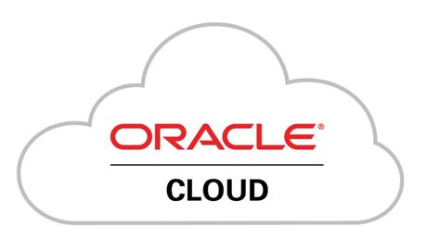




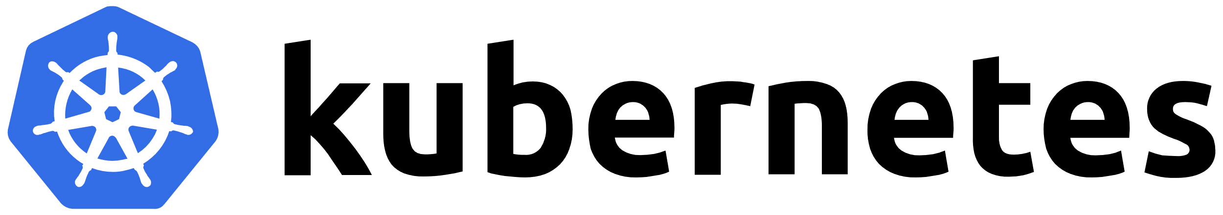


Any cloud or edge infrastructure
Application code
Microservices written in
Any code or framework…
HTTP API
gRPC API
Service-to-service invocation
State management
Publish and subscribe
Resource bindings and triggers
Actors
Observability
Secrets
Extensible
Hosting infrastructure
Azure Arc
On-Premises

Slide 43
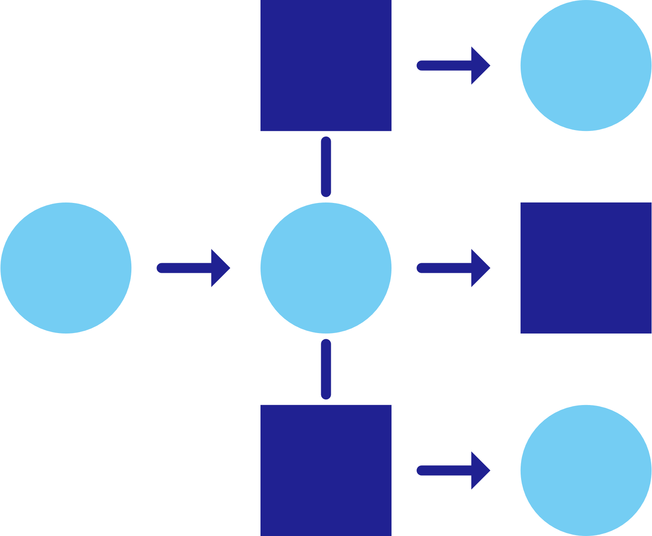

Service Discovery and Invocation
mDNS
Multicast DNS component for service discovery
My App
Service A
mTLS encryption
DAPR_HTTP_PORT=3500
POST
http://localhost:3500/v1.0/invoke/servicea/method/neworder
POST
http://10.0.0.2:8000/neworder
{"data":"Hello World"}
{"data":"Hello World"}

Slide 44
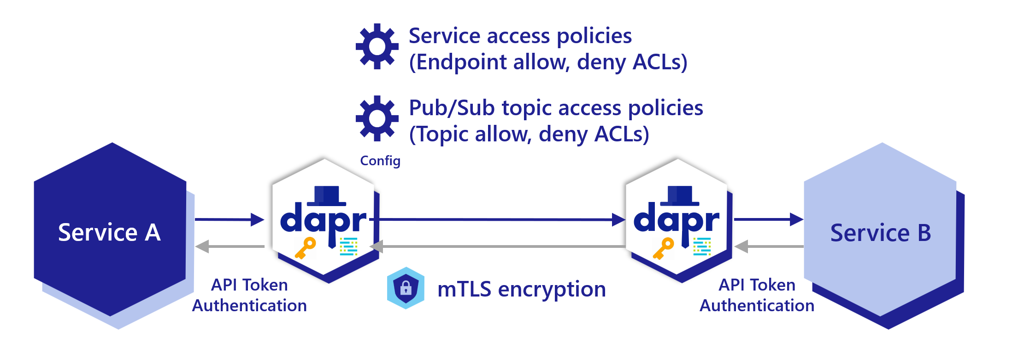
Service Discovery and Invocation
gRPC and HTTP
Service to Service security
encryption (also of statestore)
access and authorization policies
Resilience
retries, timeouts, circuit breakers, load balancing
Pluggable Service Discovery & Name Resolution
Consul, mDNS, Kubernetes
Telemetry
tracing & metrics are published as OpenTelemetry

Slide 45
Publish and subscribe
Service A
My App
Redis
Cache
Service B
POST
http://localhost:3500/v1.0/publish/orders/processed
POST
http://10.0.0.2:8000/orders
http://10.0.0.4:8000/factory/orders
{"data":"Hello World"}
{"data":"Hello World"}

Slide 46



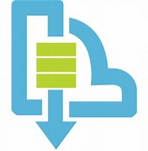

Publish and subscribe components
AWS SNS
Service A
My App
Redis
Cache
Service B
NATS
Azure Service Bus
GCP Pub/
Sub

Slide 47

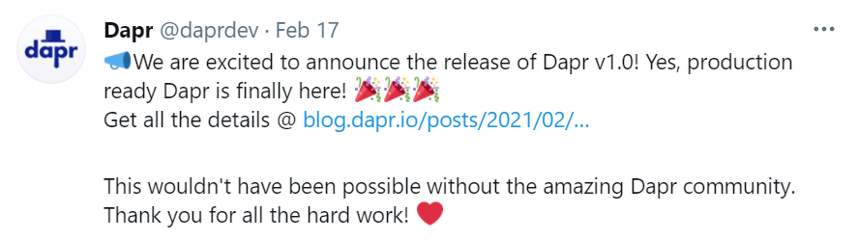
Input Bindings (triggers)
Twitter
My App
POST
http://10.0.0.2:8000/newtweet
{"data":“📢 We are excited to announce the …"}

Slide 48

Output bindings
My App
Twilio
POST
http://localhost:3500/v1.0/bindings/twilio
Hello World
{"data":"Hello World"}

Slide 49


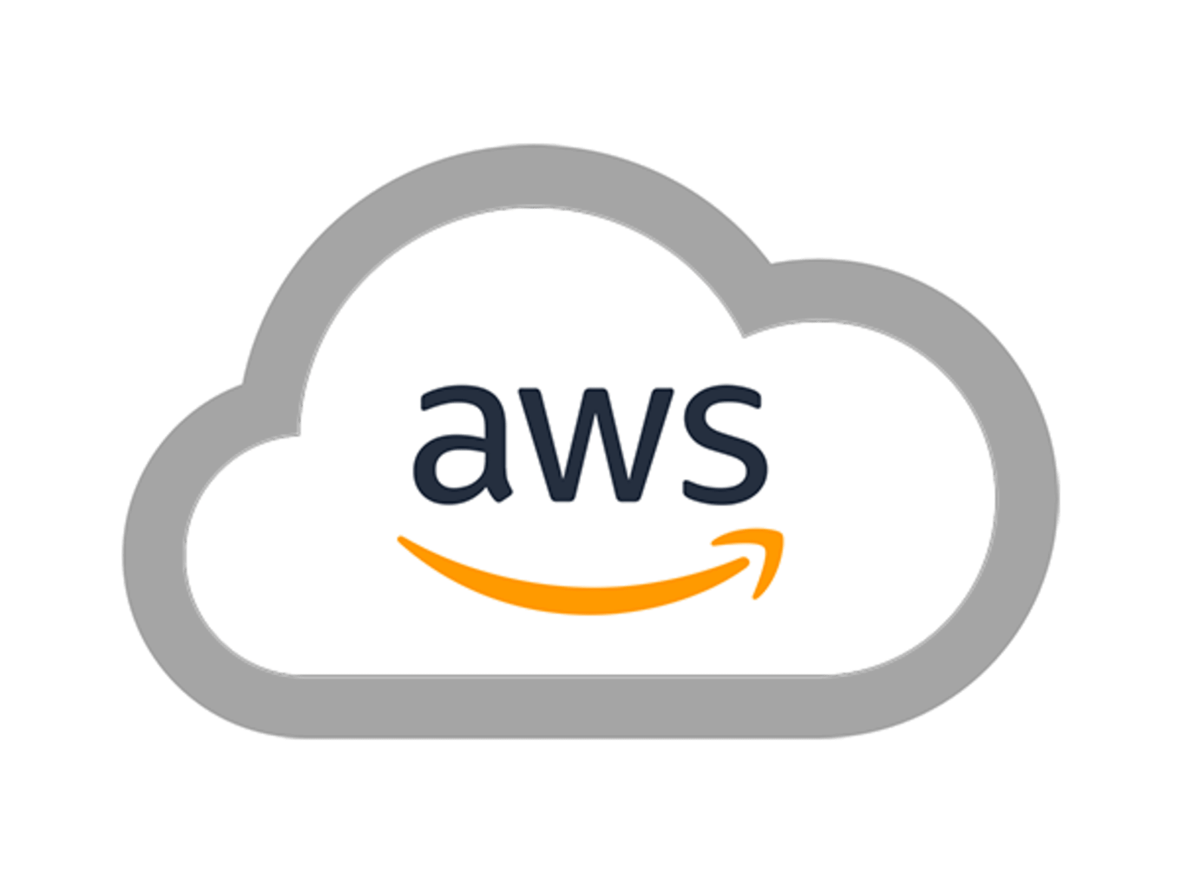

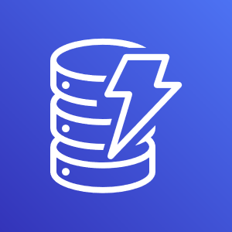
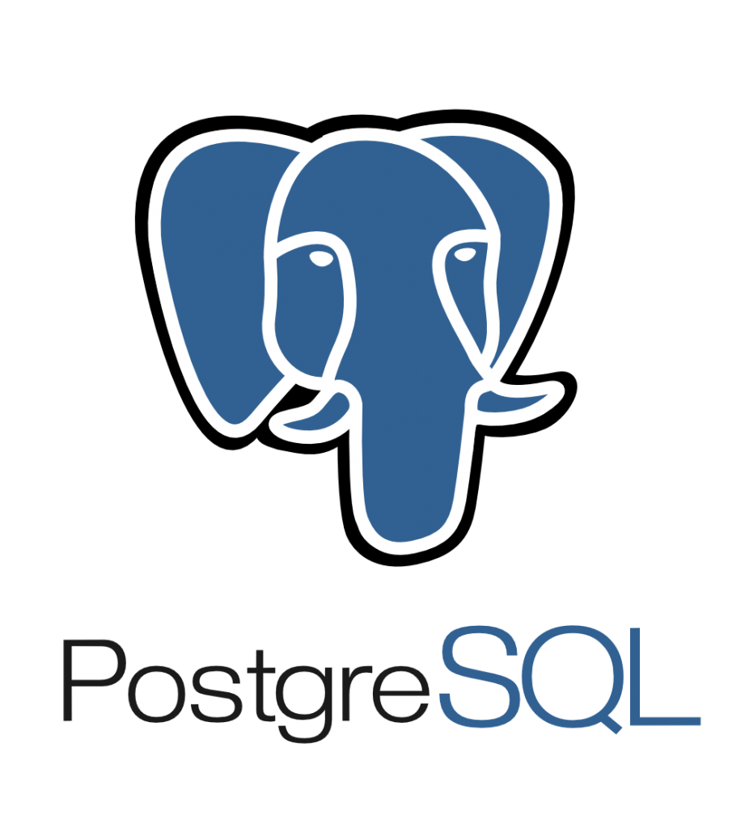


Dapr Sidecar can forward requests to many different components through output bindings
some tool that “speaks” HTTP
simple HTTP communication is converted to component specific interactions
your application
Kafka
AWS
DynamoDB
Azure
CosmosDB
Redis
Azure
Service Bus
dapr run --app-id dummy
--dapr-http-port $DAPR_HTTP_PORT --components-path dapr-components
RabbitMQ
Firebase
GCP
Pub/Sub
dapr-components.yaml
run Dapr sidecar – without actual application to be the companion for
define output bindings (with endpoints, credentials, configuration)
Cassandra

Slide 50
Curl talking to MySQL – through Dapr Sidecar & Output Binding
curl -X POST -H 'Content-Type: application/json' http://localhost:$DAPR_HTTP_PORT/v1.0/bindings/durable-data-store -d '{ "metadata": { "sql": "INSERT INTO people (PersonID, LastName, FirstName, City)
VALUES (42, \"Jefferson\", \"Thomas\", \"Washington\")" } , "operation": "exec" }'
curl
dapr run --app-id dummy
--dapr-http-port $DAPR_HTTP_PORT --components-path dapr-components
dapr-components.yaml
define output binding for MySQL database (with endpoints, credentials)

Slide 51


Secrets
My App
HashiCorp Vault
key | value
mysecret | "supersecret"
GET
http://localhost:3500/v1.0/secrets/vault/mysecret
"supersecret"

Slide 52
Configuration
Redis Cache
My App
key | value
appconfig1 | "setting A"
GET
http://localhost:3500/v1.0/configuration/store/appconfig1
"setting A"

Slide 53
Virtual actors
Host/Pod
Stateful, objects of storage and compute
Dapr Actor features:
Distribution and failover
Turn-based concurrency
State management
Timers
Reminders
Video Game Enemy
X pos
Y pos
Z pos
Difficulty
Spawn( )
Host/Pod
Weapons
Attack( )
Virtually identical to Service Fabric Reliable Actors

Slide 54
Virtual actors
Actor B
Actor E
My
Actor
Pod 1
Actor A
Actor G
Dapr actor Placement service
Placement
Actor C
Actor F
My App
Actor Y
Actor V
POST
http://localhost:3500/v1.0/actors/MyActor/A/method/update
My
Actor
Pod 2
Actor Z
Actor T
{"speed":"1"}
Actor X
Actor U

Slide 55






Observability
Service A
Twitter
My App
Redis
Cache
Service B
OpenTelemetry collector
Logging &
tracing extensions

Slide 56
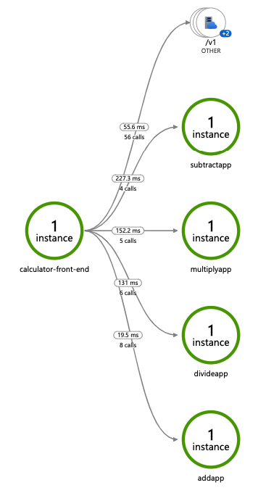
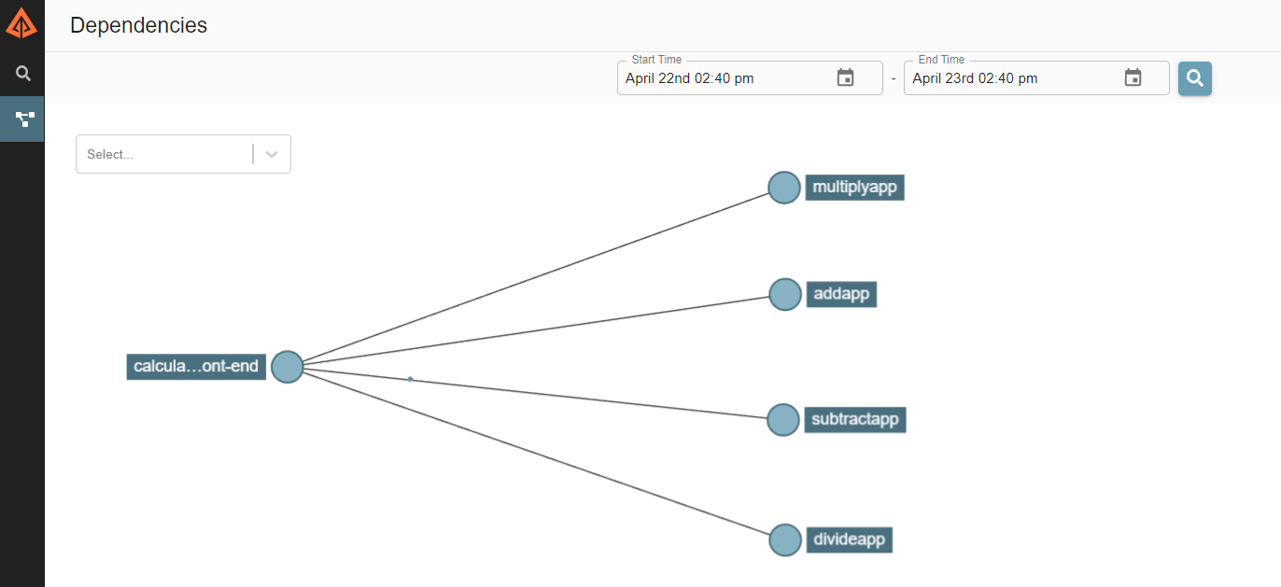
Observability: Distributed tracing
Emit tracing data from calls to/from Dapr sidecars and system services for easy application-level instrumentation
Dapr distributed tracing features:
Call graphs using Trace Ids and Trace scopes
Capture call metrics
Configurable sampling rates
ZipKin and Open Telemetery protocols write to OpenTelemetry Collector

Slide 57


Backend Monitoring Tools
Visualize
Backend Monitoring Tools
And more…
Your tool of choice
Service A
Service A
Service B
W3C tracing context
Service C
Service invocation
Collector
W3C tracing context
W3C tracing context
Service B
Publish
Subscribe
Service C
Pub/Sub component
Notes:
Service A makes an http/gRPC call meant for Service B. The call goes to the local Dapr sidecar.
Dapr discovers Service B’s location using the name resolution component installed for the given hosting platform.
Dapr forwards the message to Service B’s Dapr sidecar
Note: All calls between Dapr sidecars go over gRPC for performance. Only calls between services and Dapr sidecars are either HTTP or gRPC
Service B’s Dapr sidecar forwards the request to the specified endpoint (or method) on Service B. Service B then runs its business logic code.
Service B sends a response to Service A. The response goes to Service B’s sidecar.
Dapr forwards the response to Service A’s Dapr sidecar.
Service A receives the response.

Slide 58
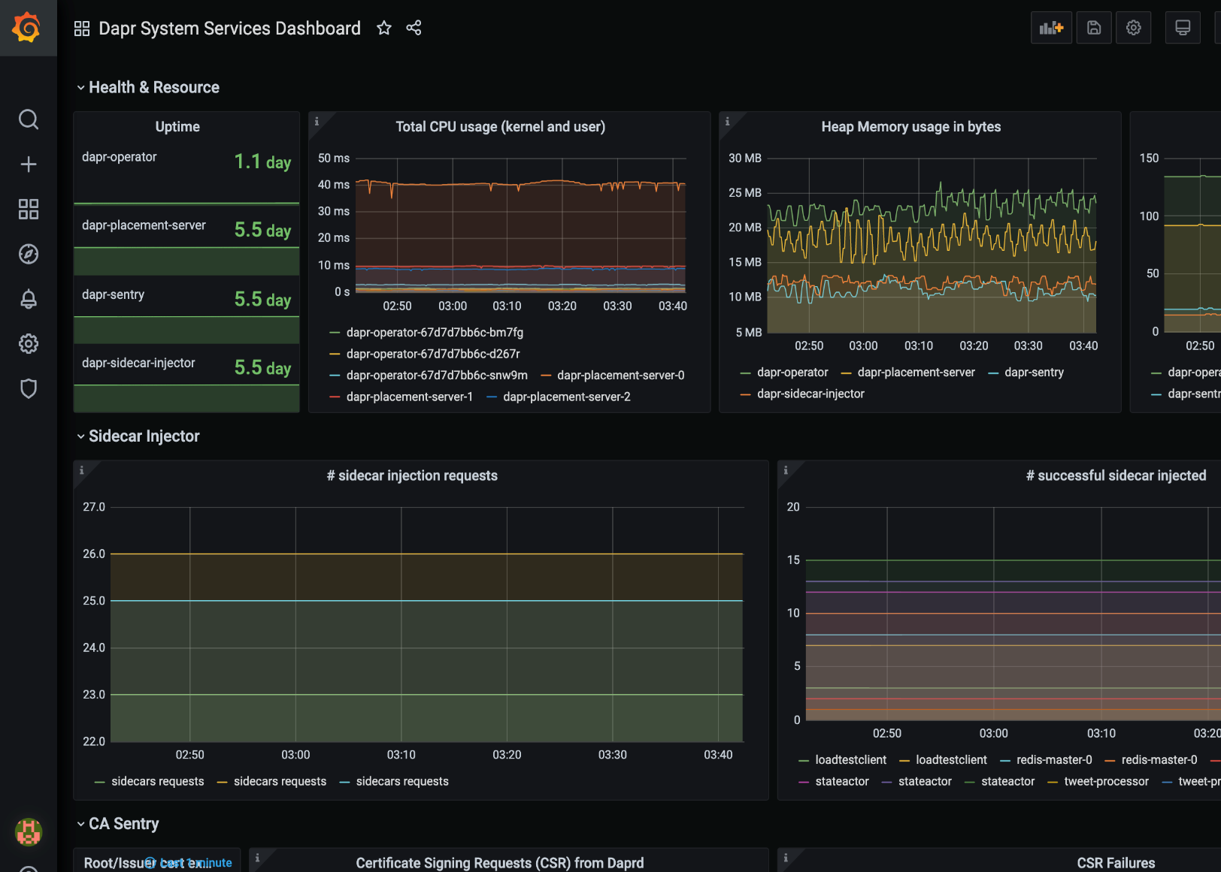
Metrics
Built-in monitoring capabilities to understand the behavior of the Dapr sidecar and system services
Dapr Metrics features:
Call latency
CPU/memory usage
Error rates
Sidecar injection failures
System health

Slide 59
Dapr hosting environments
Get started with dapr init
Easy setup with Docker images
Sets up placement, Zipkin, Redis
slim-init available without Docker
Run any application with Dapr sidecar using dapr run
Slim mode does executable deployment (no Docker images)
Self-hosted

Slide 60
Dapr hosting environments
Get started with dapr init
Easy setup with Docker images
Sets up placement, Zipkin, Redis
slim-init available without Docker
Run any application with Dapr sidecar using dapr run
Slim mode does executable deployment (no Docker images)
Self-deploy Dapr control plane per machine
Deploy Hashicorp Consul per machine
Run any application with Dapr sidecar using dapr run
Dapr Installer Package allows for offline/remote deployments with no network connectivity
Virtual/Physical Machines
Self-hosted

Slide 61
Dapr hosting environments
Get started with dapr init
Easy setup with Docker images
Sets up placement, Zipkin, Redis
slim-init available without Docker
Run any application with Dapr sidecar using dapr run
Slim mode does executable deployment (no Docker images)
Self-deploy Dapr control plane per machine
Deploy Hashicorp Consul per machine
Run any application with Dapr sidecar using dapr run
Dapr Installer Package allows for offline/remote deployments with no network connectivity
Get started with dapr init -k
Integrated Dapr control plane
Deploys dashboard, placement, operator, sentry, and injector pods
Automatically inject Dapr sidecar into all annotated pods
Upgrade with dapr upgrade or Helm
Virtual/Physical Machines
Self-hosted

Slide 62
Dapr in self-hosted Docker mode
Dapr Components
dapr run myapp
State Stores
Launch application
Launch sidecar process
Set env variables
PubSub
Brokers
My App
Use components
Bindings
& Triggers
Zipkin
tracing
Zipkin
Send distributed tracing
Secret Stores
Redis
state store
Redis
Save and retrieve state
Publish and subscribe to messages
dev machine or VM – local or cloud
Observability

Slide 63


Cluster of VMs
Dapr in self-hosted mode on multiple VMs – across environments
VM 2
Dapr Components
VM 1
VM 3
Service A
Service B
State Stores
PubSub
Brokers
Consul agent server (leader)
Consul agent server (follower)
Consul agent server (follower)
Consul used for DNS name resolution
Bindings
& Triggers
Actor
Placement
Actor
Placement
Actor
Placement
Placement
Create mapping table of actor instances
Placement
Placement
Secret Stores
Cert authority
& identity
Cert authority
& identity
Cert authority
& identity
Sentry
Sentry
Sentry
Observability
Assign Spiffe identity
Manage mTLS between services
File store for
certificates
Configuration

Slide 64

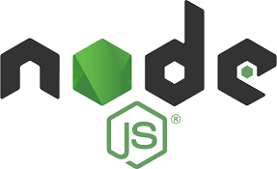


Slide 65
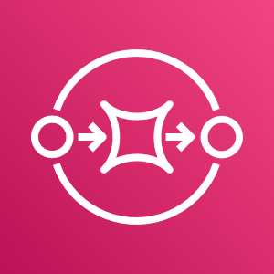






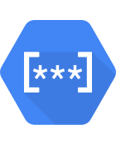

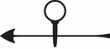

Dapr and Node Applications
State
Stores
AWS
DynamoDB
Azure
CosmosDB
Firebase
Redis
Cassandra
PubSub
Brokers
AWS
SQS
Azure
Service Bus
GCP
Pub/Sub
Redis
RabbitMQ
Bindings
& Triggers
AWS
S3
Azure
Storage
GCP
Storage
Twilio
Kafka
Secret
Stores
AWS
Secrets Manager
Azure
KeyVault
GCP
Secret Manager
HashiCorp
Vault
Kubernetes
Secret
HTTP (or gRPC) with Dapr SideCar
easier yet: Node SDK for Dapr
Leverage Dapr and its building blocks for
simple state management
simple publication of messages
subscription to incoming messages
retrieving secrets
retrieving configuration data
invoking external services (database, message broker, store, API)
register as listener to inbound requests and messages for external services
decoupled interaction between microservices – implemented in potentially very different languages
Observability
Prometheus
AppInsights
Zipkin
Jaeger
Node SDK for Dapr
components.yaml
sidecar (the personal assistant)

Slide 66

State Management with Dapr from Node application
State
Stores
AWS
DynamoDB
Azure
CosmosDB
Firebase
Redis
Cassandra
state store interface
State Store components
Node SDK for Dapr
set & get state
components.yaml
sidecar (the personal assistant)

Slide 67
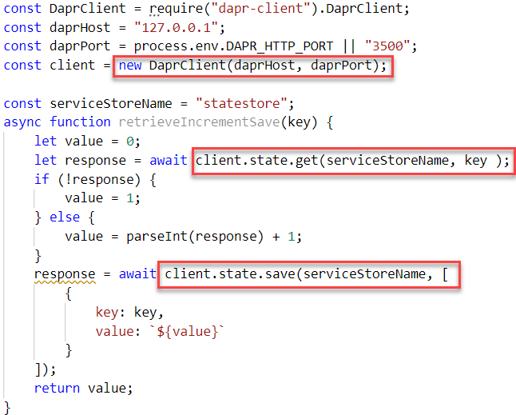
State Management with Dapr from Node application
connect to sidecar
State
Stores
AWS
DynamoDB
Azure
CosmosDB
Firebase
Redis
Cassandra
state store interface
retrieve state
State Store components
Node SDK for Dapr
set state
set & get state
components.yaml
sidecar (the personal assistant)

Slide 68
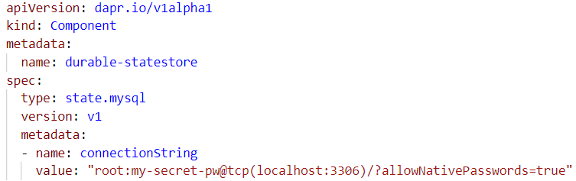
State Management with Dapr from Node application - switch to MySQL state store with configuration change
connect to sidecar
State
Stores
Azure
CosmosDB
Firebase
Redis
Cassandra
state store interface
retrieve state
State Store components
Node SDK for Dapr
set state
set & get state
components.yaml
sidecar (the personal assistant)

Slide 69
State Management with Dapr from any application - either through SDK or using HTTP or gRPC – to any store
State
Stores
AWS
DynamoDB
Azure
CosmosDB
Firebase
Redis
Cassandra
MySQL
state store interface
SDK for Dapr
State Store components
set & get state
components.yaml
sidecar (the personal assistant)

Slide 70

Pub/Sub with Dapr from Node applications
PubSub
Brokers
Azure
Service Bus
GCP
Pub/Sub
Redis
RabbitMQ
pub interface
sub interface
Pub/Sub components
Pub/Sub components
message sent to handler
Node SDK for Dapr
Node SDK for Dapr
subscribe on topic with handler function
publish message
components.yaml
sidecar (the personal assistant)
sidecar (the personal assistant)
components.yaml

Slide 71
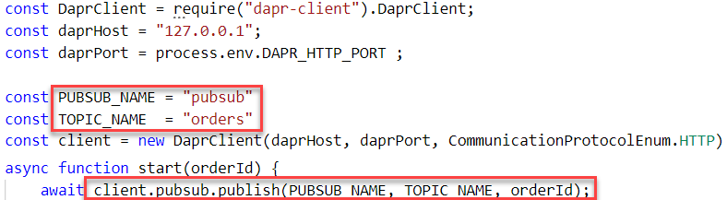
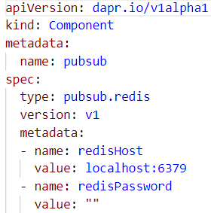
Pub/Sub with Dapr from Node applications
PubSub
Brokers
Azure
Service Bus
GCP
Pub/Sub
Redis
RabbitMQ
pub/sub interface
Pub/Sub
components
publish message
Node SDK for Dapr
publish message
components.yaml
sidecar (the personal assistant)

Slide 72
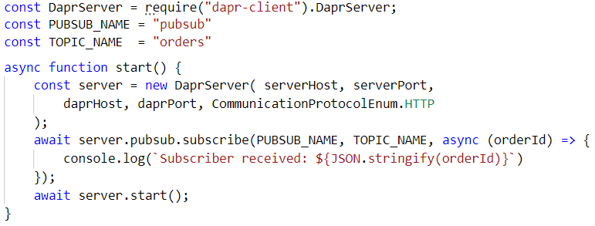
Pub/Sub with Dapr from Node applications
PubSub
Brokers
AWS
SQS
Azure
Service Bus
GCP
Pub/Sub
Redis
RabbitMQ
message sent to handler
pub/sub interface
subscribe on topic
Pub/Sub
components
Node SDK for Dapr
sidecar (the personal assistant)
components.yaml

Slide 73
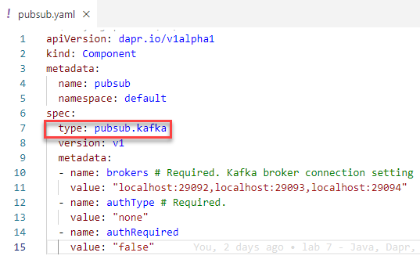

Node with Kafka – through Dapr
Producer
Consumer

Slide 74

Asynchronous Interaction between Microservices
http
Front App
Node App

Slide 75
Asynchronous Interaction between Microservices
http
Front App
Node App

Slide 76
Asynchronous Interaction between Microservices
PubSub
Brokers
Redis
RabbitMQ
publish
consume
name = John
http
Front App
subscribe
Node App
get
get & set
State
Stores
AWS
DynamoDB

Slide 77


Telemetry Observation in Zipkin
Telemetry Data
PubSub
Brokers
Redis
RabbitMQ
publish
consume
name = John
http
greeter
subscribe
name-processor
get
get & set
State
Stores
AWS
DynamoDB

Slide 78
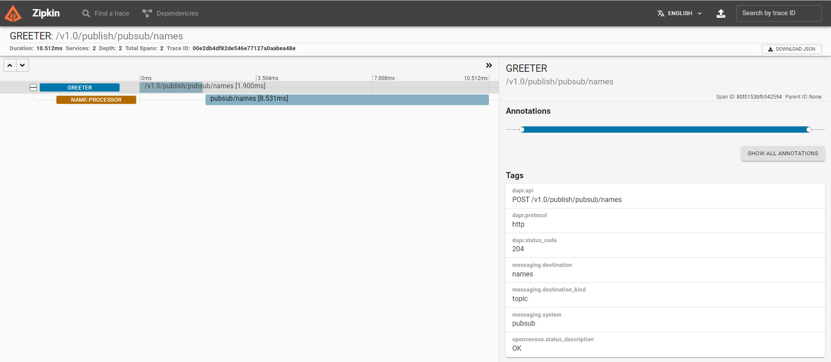
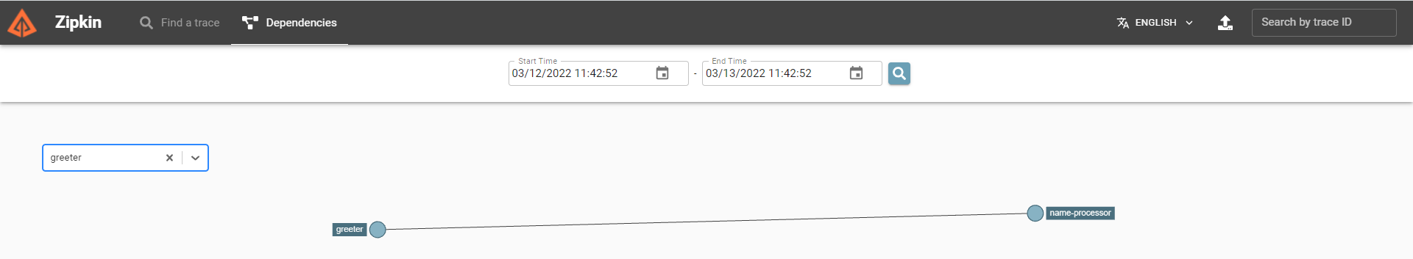
Telemetry Observation in Zipkin
Telemetry Data
PubSub
Brokers
Redis
RabbitMQ
publish
consume
name = John
http
Front App
Node App
subscribe
get
get & set
State
Stores
AWS
DynamoDB

Slide 79

Handson Labs

Slide 80




Handson – Trying your hand at Dapr + Kafka + Node + more
The Linux Ubuntu environment contains
Dapr
MySQL
Redis
Zipkin
Kafka Cluster (3 brokers)
AKHQ (Kafka GUI)
runtimes for Node and Java
VS Code
Docker
Docker Compose
9092
Docker Compose
29092
28042
Browser
Terninal
workspace

Slide 81
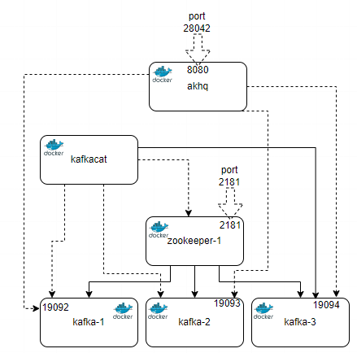

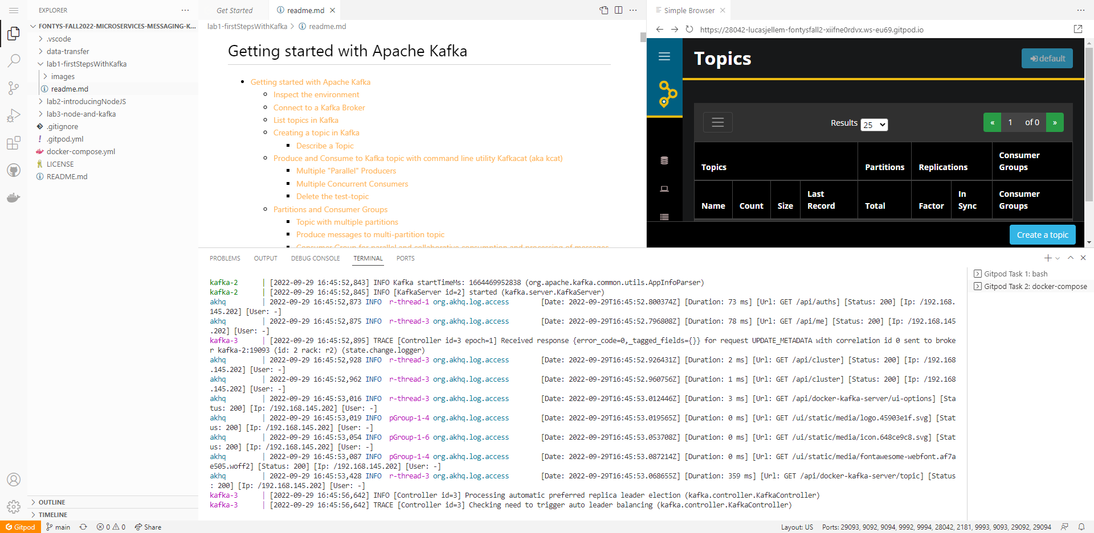
Workshop Environment
Launch GitHub lab repo into Gitpod workspace
GitHub repository: github.com/lucasjellema/fontys-fall2022-microservices-messaging-kafka-dapr
gitpod.io#https://lucasjellema/fontys-fall2022-microservices-messaging-kafka-dapr
workspace
Notes:
gitpod.io#https://lucasjellema/fontys-fall2022-microservices-messaging-kafka-dapr

Slide 82
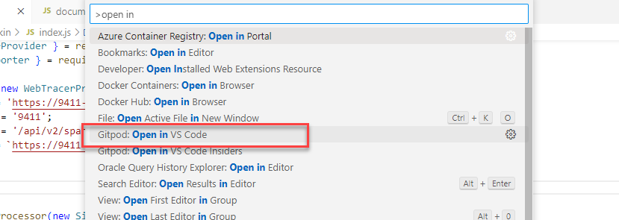
Open Gitpod Workspace in local IDE

Slide 83
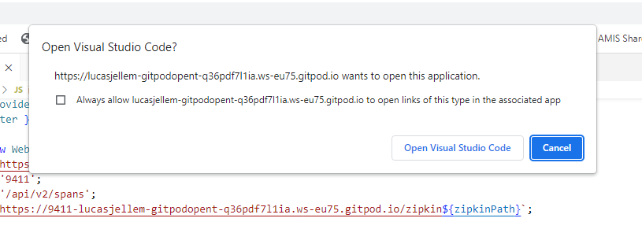
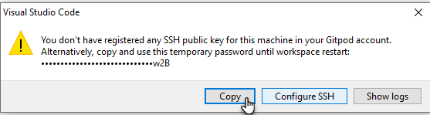
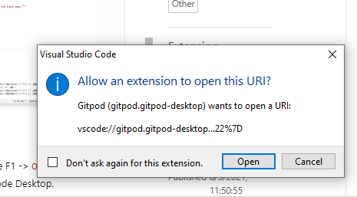
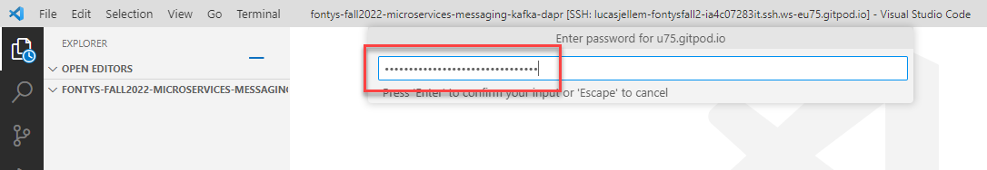
Open local VS Code and provide SSH Token

Slide 84
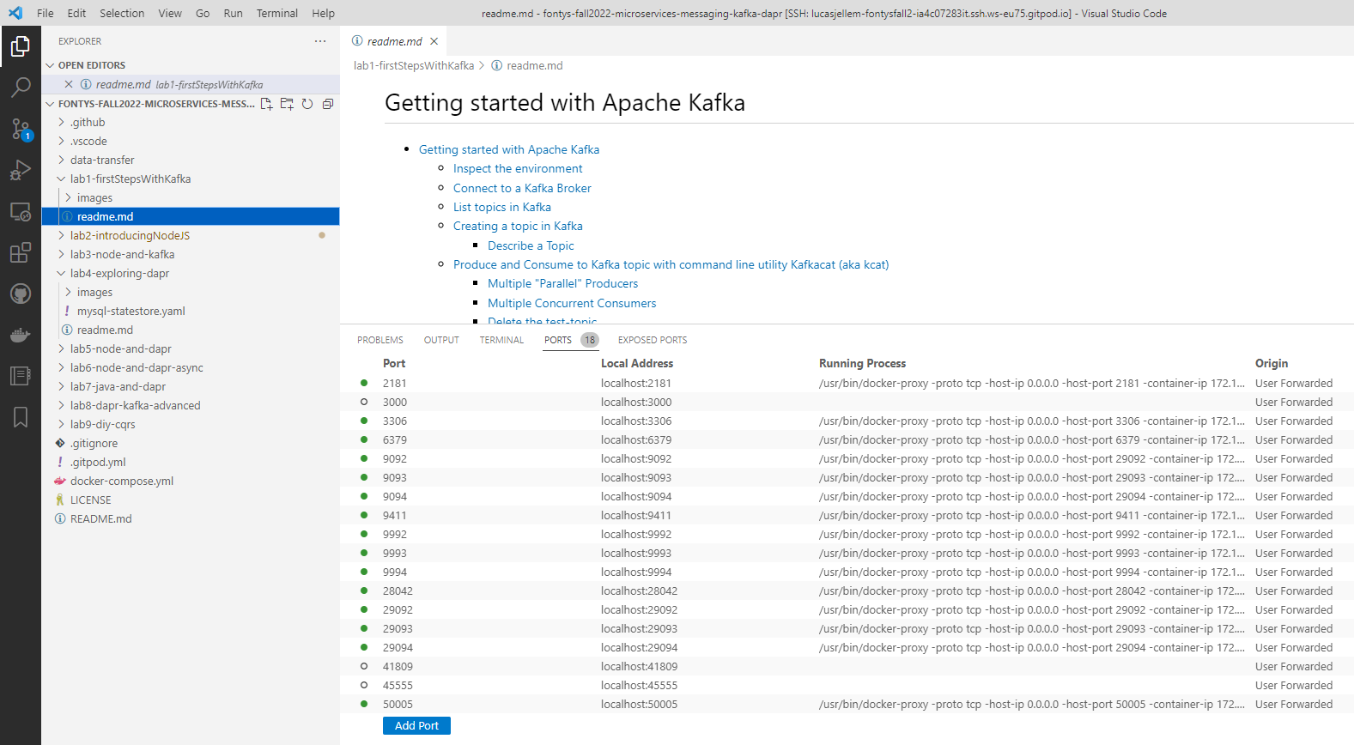
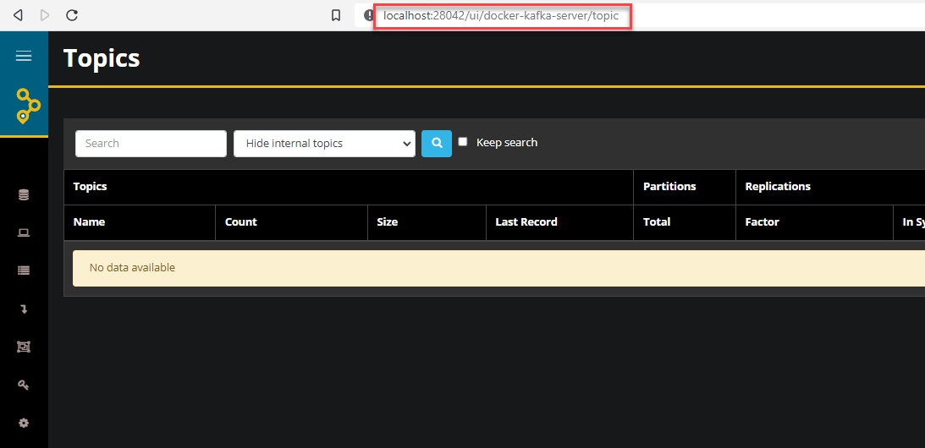
Services running in Gitpod Workspace can accessed locally

Slide 85
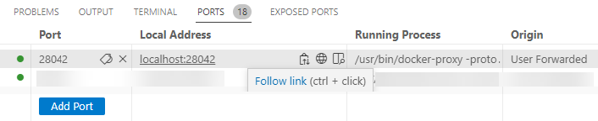
Services running in CDE can be accessed locally thanks to Port Forwarding

Slide 86
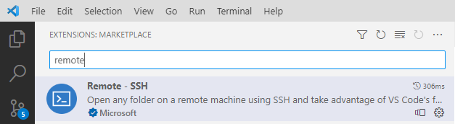

Port Forwarding with VS Code
Requires MS Remote SSH Extension
Configure .ssh/config

Slide 87

Labs on Kafka and Node and Dapr
Explore Dapr from the command line – lab 4
Programmatically work with Dapr from Node – and with Apache Kafka with Dapr as intermediary – lab 5 and 6
Add MySQL as State Store in the mix
Have a Java microservice interact with Dapr – to work indirectly with Node app through Kafka – lab 7

Slide 88
topic: names
PubSub
Brokers
dapr run --app-port 8080 --app-id name-processor
--components-path ../dapr-components
-- java -jar target/NameConsumerAndProcessor-0.0.1-SNAPSHOT.jar
publish to topic names on pubsub component
dapr run --app-id greeter --app-port $APP_PORT
--dapr-http-port $DAPR_HTTP_PORT --components-path dapr-components node front-app.js
publish
consume
consume messages from topic names
front-app.js
NameConsumer AndProcessor
subscribe
subscribe to topic names on pubsub component
dapr-components/pubsub.yaml
dapr-components/pubsub.yaml

Slide 89



NameConsumer AndProcessor
dapr-components/pubsub.yaml

Slide 90
NameConsumer AndProcessor
dapr-components/pubsub.yaml

Slide 91

Labs on Kafka and Node and Dapr
Explore Dapr – lab 4
Programmatically work with Kafka from Node – with Dapr as intermediary – lab 5 and 6
publishing and consuming messages
Add MySQL as State Store in the mix
Have a Java microservice interact with Dapr – to work indirectly with Node app through Kafka – lab 7
Some more advanced use cases – lab 8 and 9

Slide 92
DIY CQRS
Handles new and changed customer details – including Connection Mandate Setting for Connection Identifier
REST API Call to POST/PUT or GET customer details including Mandate
REST API Call to GET Mandate Setting for Connection
Publish Event to Kafka Topic for every new or changed Connection Mandate Setting
CRM
IoT Platform
Need to have the SmartMeter Mandate Setting for every ConnectionId for
Consume Event and Record new Mandate Setting for Connection Identifier
connection-mandates-topic

Slide 93
DIY Command Query Responsibility Segregation
CRM
IoT Platform
Redis

Slide 94
DIY Read Only Query Store (cross service data replication)
dapr run --app-id iot-platform --app-port $APP_PORT --dapr-http-port $DAPR_HTTP_PORT
--components-path dapr-components node app.js
dapr run --app-id crm --app-port $APP_PORT --dapr-http-port $DAPR_HTTP_PORT --components-path dapr-components node app.js
Connection Mandate Update
curl http://localhost:$APP_PORT ?connectionId=7733
curl POST http://localhost:$APP_PORT/customers -H "Content-Type: application/json" -d '{ "firstName": "Molly","lastName": "Peterson", "city": "Zeewolde", "connectionId": "928", "connectionMandate": "0"}'
CRM
IoT Platform
csv
Redis
connection-mandates-topic

Slide 95



Summary
=> == =>
=>
Dapr supports applications with common, generic, non-functional tasks
simple state management, pub/sub interaction, service invocation, secret retrieval
Dapr provides application wide facilities – Kubernetes cluster wide or across VMs
resilience, telemetry, security, service discovery, actor management
Dapr can be used from microservices in any programming language
Dapr works with dozens of components | platforms | technologies
and decouples code from specific technologies
Try out Dapr for quick prototyping and explorations
and for the handson labs
=>

Slide 96
































lucas.jellema@amis.nl | technology.amis.nl | @lucasjellema | lucas-jellema
you are invited to come do an internship and explore job opportunities with us!

Slide 97
workaround: direct call to other app’s sidecar because call from side car to side car (may) fail in some environments
Default, out of the box
?name=Joseph
?name=John
dapr_host, dapr_http_port
http
http
app_port
components.yaml
app_port
app.js
app.js
Node SDK for Dapr
Node SDK for Dapr
get & set
name, instance count
State
Stores
key | value
John Monty | 3 2
AWS
DynamoDB

Slide 98
curl localhost:3620/v1.0/invoke/frontapp/method/greet?name=Klaas
1
nodeapp
frontapp
dapr_http_port = 3510
app_port= 3110
app_port= 3220
5
frontapp.js
2
4
app.js
3
6
Node SDK for Dapr
Node SDK for Dapr
7
get & set
dapr_http_port = 3620
dapr_http_port = 3620
components.yaml
name, instance count
State
Stores
key | value
John Klaas | 3 1
AWS
DynamoDB
8

Slide 99

curl localhost:3620/v1.0/invoke/frontapp/method/greet?name=Klaas
Telemetry Data
nodeapp
frontapp
frontapp.js
app.js
get & set
State
Stores
key | value
John Klaas | 3 1
AWS
DynamoDB

Slide 100
curl localhost:3510/v1.0/invoke/frontapp/method/greet?name=Klaas
1
nodeapp
frontapp
dapr_http_port = 3510
app_port= 3110
app_port= 3220
2
6
frontapp.js
3
5
app.js
4
7
Node SDK for Dapr
Node SDK for Dapr
8
get & set
dapr_http_port = 3620
dapr_http_port = 3620
components.yaml
State
Stores
key | value
John Klaas | 3 2
AWS
DynamoDB
9

Slide 101
nodeapp
$APP_PORT
DAPR_HTTP_PORT
app.js
Node SDK for Dapr
dapr run --app-id nodeapp --app-port $APP_PORT --dapr-http-port $DAPR_HTTP_PORT node app.js
Default, out of the box
components.yaml
State
Stores
AWS
DynamoDB

Slide 102
APP_PORT = 3110
curl http://localhost:3110/?name=Joseph
app.js
(Joseph, 1)
Node SDK for Dapr
DAPR_HTTP_PORT= 3510
(Joseph, 1)
get & set
components.yaml
State
Stores
key | value
Joseph instance-sequence-number | 1 1
AWS
DynamoDB

Slide 103
curl localhost:3510/v1.0/invoke/nodeapp/method/?name=Joseph
nodeapp
invoke nodeapp at port 3110
APP_PORT = 3110
DAPR_HTTP_PORT= 3510
app.js
Node SDK for Dapr
set (Joseph, 2)
(Joseph, 2)
get & set
components.yaml
State
Stores
key | value
Joseph instance-sequence-number | 2 1
AWS
DynamoDB

Slide 104
after restart of dapr & nodeapp – new instance-sequence number
curl localhost:3510/v1.0/invoke/nodeapp/method/?name=Joseph
brand new nodeapp instance
invoke nodeapp at port 3110
APP_PORT = 3110
DAPR_HTTP_PORT= 3510
app.js
Node SDK for Dapr
set (Joseph, 3)
(Joseph, 3)
get & set
components.yaml
State
Stores
key | value
Joseph instance-sequence-number | 3 2
AWS
DynamoDB

Slide 105
topic: orders
PubSub
Brokers
publish to topic orders on pubsub component
Redis
publish
publisher.js

Slide 106
topic: orders
PubSub
Brokers
Redis
consume
subscribe
consumer.js
subscribe to topic orders on pubsub component

Slide 107
topic: orders
PubSub
Brokers
publish to topic orders on pubsub component
Redis
consume
publish
publisher.js
subscribe
consumer.js
subscribe to topic orders on pubsub component

Slide 108
topic: names
PubSub
Brokers
publish to topic names on pubsub component
dapr run --app-id name-processor --app-port $APP_PORT --dapr-http-port $DAPR_HTTP_PORT
--components-path dapr-components node app.js
dapr run --app-id greeter --app-port $APP_PORT
--dapr-http-port $DAPR_HTTP_PORT --components-path dapr-components node front-app.js
publish
consume
consume messages from topic names
front-app.js
subscribe
app.js
subscribe to topic names on pubsub component
dapr-components/pubsub.yaml
dapr-components/pubsub.yaml

Slide 109
topic: names
PubSub
Brokers
dapr run --app-port 8080 --app-id name-processor
--components-path ../dapr-components
-- java -jar target/NameConsumerAndProcessor-0.0.1-SNAPSHOT.jar
publish to topic names on pubsub component
dapr run --app-id greeter --app-port $APP_PORT
--dapr-http-port $DAPR_HTTP_PORT --components-path dapr-components node front-app.js
publish
consume
consume messages from topic names
front-app.js
NameConsumer AndProcessor
subscribe
subscribe to topic names on pubsub component
dapr-components/pubsub.yaml
dapr-components/pubsub.yaml

Slide 110
Bindings
& Triggers
Azure
Storage
GCP
Storage
Twilio
AWS
S3
publish to topic names on pubsub component
dapr run --app-id name-processor --app-port $APP_PORT --dapr-http-port $DAPR_HTTP_PORT
--components-path dapr-components node app.js
dapr run --app-id greeter --app-port $APP_PORT
--dapr-http-port $DAPR_HTTP_PORT --components-path dapr-components node front-app.js
publish
consume
consume messages from topic names
front-app.js
subscribe
app.js
subscribe to topic names on pubsub component
define Dapr Kafka input binding configuration
define Dapr Kafka output binding configuration
dapr-components/input.yaml
dapr-components/output.yaml

Slide 111
Dapr Sidecar can forward requests to many different components through output bindings
some tool that “speaks” HTTP
simple HTTP communication is converted to component specific interactions
your application
Kafka
AWS
DynamoDB
Azure
CosmosDB
Redis
Azure
Service Bus
dapr run --app-id dummy
--dapr-http-port $DAPR_HTTP_PORT --components-path dapr-components
RabbitMQ
Firebase
GCP
Pub/Sub
dapr-components.yaml
run Dapr sidecar – without actual application to the companion for
define output bindings (with endpoints, credentials, configuration)
Cassandra

Slide 112
Curl talking to MySQL – through Dapr Sidecar & Output Binding
curl -X POST -H 'Content-Type: application/json' http://localhost:$DAPR_HTTP_PORT/v1.0/bindings/durable-data-store -d '{ "metadata": { "sql": "INSERT INTO people (PersonID, LastName, FirstName, City) VALUES (42, \"Jefferson\", \"Thomas\", \"Washington\")" }, "operation": "exec" }'
curl
dapr run --app-id dummy
--dapr-http-port $DAPR_HTTP_PORT --components-path dapr-components
Kafka
Redis
dapr-components.yaml
define output binding for MySQL database (with endpoints, credentials)

Slide 113
DIY CQRS
Handles new and changed customer details – including Connection Mandate Setting for Connection Identifier
REST API Call to POST/PUT or GET customer details including Mandate
REST API Call to GET Mandate Setting
Publish Event to Kafka Topic for every new or changed Connection Mandate Setting
CRM
IoT Platform
Need to have the SmartMeter Mandate Setting for every ConnectionId for
Consume Event and Record new Mandate Setting for Connection Identifier
Initial data load from file
csv

Slide 114
DIY CQRS
Handles new and changed customer details – including Connection Mandate Setting for Connection Identifier
REST API Call to POST/PUT or GET customer details including Mandate
REST API Call to GET Mandate Setting
Publish Event to Kafka Topic for every new or changed Connection Mandate Setting
CRM
IoT Platform
Need to have the SmartMeter Mandate Setting for every ConnectionId for
Consume Event and Record new Mandate Setting for Connection Identifier
Initial data load from file
csv
connection-mandates-topic

Slide 115
REST API Call to GET Mandate Setting
IoT Platform
curl http://localhost:$APP_PORT ?connectionId=7733
IoT Platform
Redis

Slide 116
DIY CQRS
dapr run --app-id iot-platform --app-port $APP_PORT --dapr-http-port $DAPR_HTTP_PORT
--components-path dapr-components node app.js
dapr run --app-id crm --app-port $APP_PORT --dapr-http-port $DAPR_HTTP_PORT --components-path dapr-components node app.js
curl http://localhost:$APP_PORT ?connectionId=7733
curl POST http://localhost:$APP_PORT/customers -H "Content-Type: application/json" -d '{ "firstName": "Molly","lastName": "Peterson", "city": "Zeewolde", "connectionId": "928", "connectionMandate": "0"}'
CRM
IoT Platform
csv
Redis
connection-mandates-topic

Slide 117
DIY CQRS
dapr run --app-id iot-platform --app-port $APP_PORT --dapr-http-port $DAPR_HTTP_PORT
--components-path dapr-components node app.js
dapr run --app-id crm --app-port $APP_PORT --dapr-http-port $DAPR_HTTP_PORT --components-path dapr-components node app.js
curl http://localhost:$APP_PORT ?connectionId=7733
curl POST http://localhost:$APP_PORT/customers -H "Content-Type: application/json" -d '{ "firstName": "Molly","lastName": "Peterson", "city": "Zeewolde", "connectionId": "928", "connectionMandate": "0"}'
CRM
IoT Platform
csv
connection-mandates-topic

Slide 118
Hands On Lab 1 – Exploring Dapr
In a Gitpod workspace
Ubuntu with Docker
Dapr already installed
with out of the box state management and pub/sub based on Redis and telemetry observation with Zipkin
Run Dapr Sidecar (“the personal assistant”)
Explore Dapr State Management APIs
from the command line (cURL HTTP calls)
Run MySQL container and have Dapr manage state in a MySQL database
Explore Dapr Telemetry collection and presentation in Zipkin
GitHub repository: github.com/lucasjellema/fontys-fall2022-microservices-messaging-kafka-dapr
gitpod.io#https://lucasjellema/fontys-fall2022-microservices-messaging-kafka-dapr
Notes:
https://github.com/lucasjellema/fontys-2022-microservices-kafka-dapr

Slide 119
Dapr in self-hosted Docker mode – add MySQL Database
dapr run --app-id myotherapp --dapr-http-port 3510 --components-path .
Launch application
Launch sidecar process
Set env variables
MySQL
database
Save and retrieve state
myotherapp
Zipkin
tracing
Zipkin
Redis
state store
mysql-statestore.yaml
Redis
dev machine or VM – local or cloud

